Slide 1

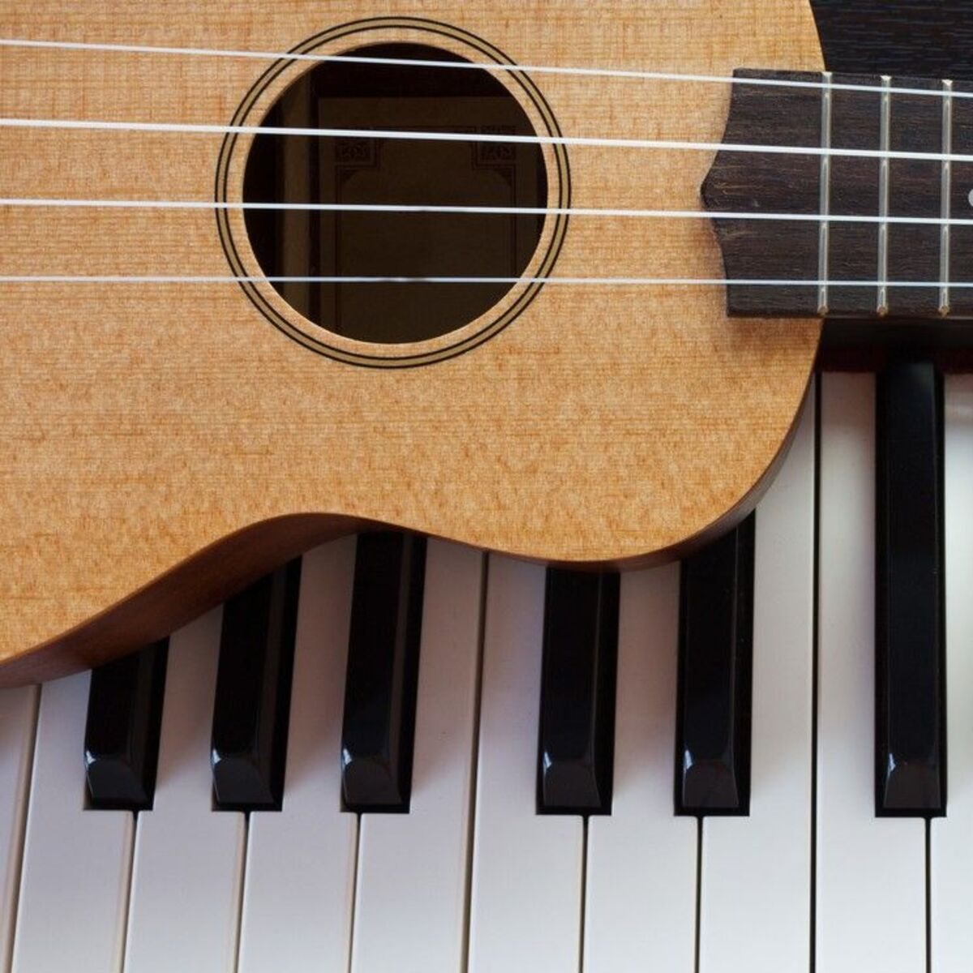
Chord Classifier
Daniel gilkarov 325010288

Slide 2
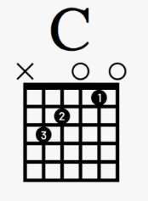
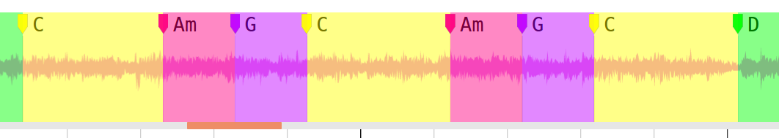
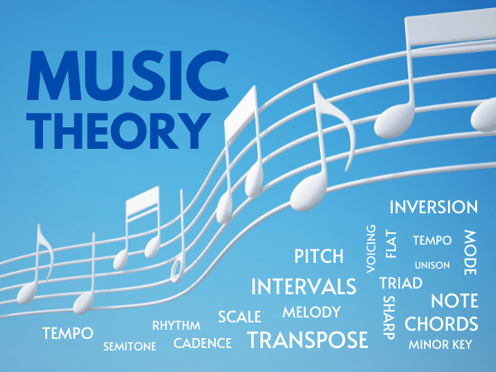
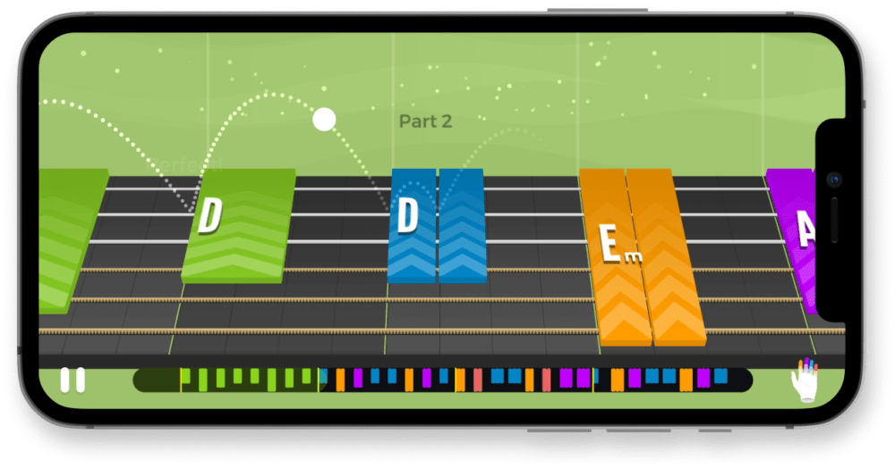
INTRODUCTION
Chord Classification is the task of labeling an input audio recording with a certain chord label
Automatic Chord Recognition is a close relative to Chord classification where an audio is segmented into 1 or more chords
Chord classification is useful for:
Music Teaching apps
Musical Analysis

Slide 3

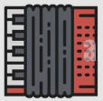
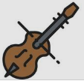


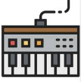




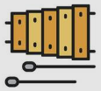

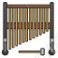

DATASETS
Training dataset
Osmalsky - Guitar, Accordion, Violin, Piano chord recordings dataset by Julien Osmalskyj
Test datasets
IDMT-SMT-CHORDS – dataset of MIDI-generated audio of guitar, keyboard chords
Multinstrument - Custom Dataset created by me used for proving robustness of model

Slide 4
DATASETS - STATISTICS
DATASET | #Samples per Instrument Ratio | General Properties
Training data: OSMALSKY |  | Real instruments Anechoic/Noisy Environment Different play styles (arpege, staccato, legato, etc.)
IDMT-SMT-CHORDS |  | Computer generated One chord per instrument preset 6 Guitar presets 10 Piano/Keyboard presets Ableton/Garageband
MULTINSTRUMENT | 10 samples for every instrument | Real instrument excerpts One chord per instrument 8 Different instruments brass/wind/bell type
Global Dataset properties
2-second-long samples
44.1KHZ Sampling rate
16-bit stream
WAV file format

Slide 5
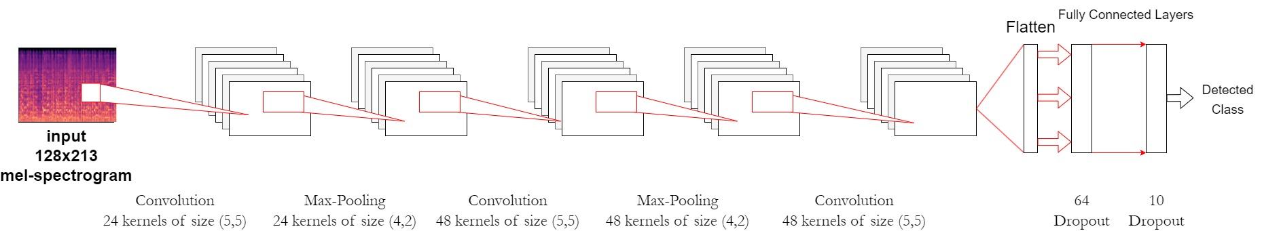
CURRENT APPROACH
Train on Osmalsky dataset, guitar data only. (65/35 train/test split)
Generate Time-stretch, pitch-shift augmentations
Generate mel-spectrograms
Input mel-spectrograms into CNN

Slide 6
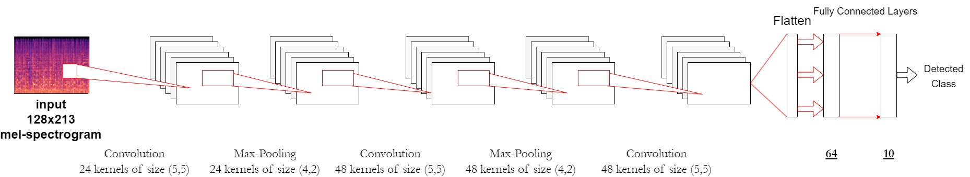
IMPROVEMENT
Train on Osmalsky dataset, all 4 instruments. (65/35 train/test split)
Generate Time-stretch, Gaussian noise augmentations (For non-guitar audio)
Generate mel-spectrograms
Log-normalize mel-spectrograms
Input mel-spectrograms into CNN (No Dropout)
* Differences from
baseline marked
like this

Slide 7
RESULTS (Baseline vs. Improvement)
Baseline results:
Improvement results:
DATASET
OSMALSKY | 94 | 31 | 43 | 34 | - | - | - | - | - | - | - | -
IDMT-SMT-CHORDS | 46 | 36 | - | - | - | - | - | - | - | - | - | -
MULTINSTRUMENT | - | - | - | - | 0 | 10 | 20 | 20 | 10 | 30 | 0 | 0
Epoch amount: 67
DATASET
OSMALSKY | 91 | 97 | 100 | 100 | - | - | - | - | - | - | - | -
IDMT-SMT-CHORDS | 88 | 81 | - | - | - | - | - | - | - | - | - | -
MULTINSTRUMENT | - | - | - | - | 90 | 90 | 90 | 90 | 80 | 90 | 30 | 50
Epoch amount:
5

Slide 8
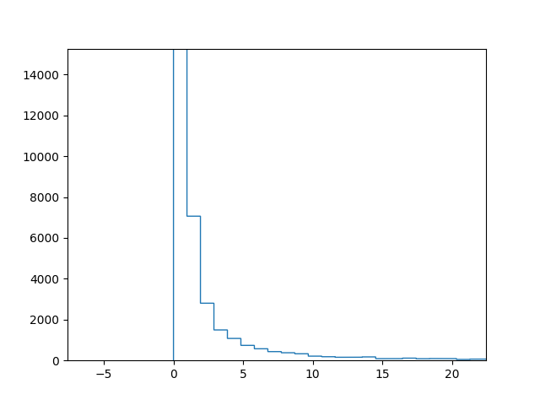
OPEN QUESTIONS & FUTURE WORK
Try different normalization functions:
BoxCox
Per-channel energy normalization
Sliding window experiments
Diversify training-instrument types
Better success with bell type instruments
Bass type instruments
Expand model to 7th chords

